Slide 1


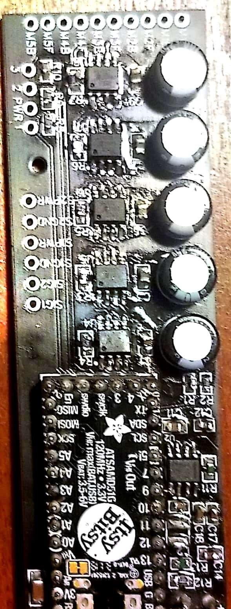
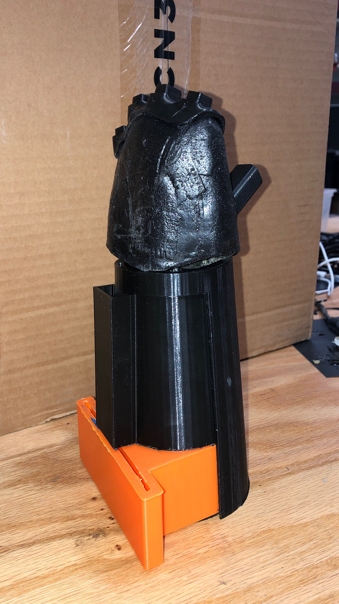
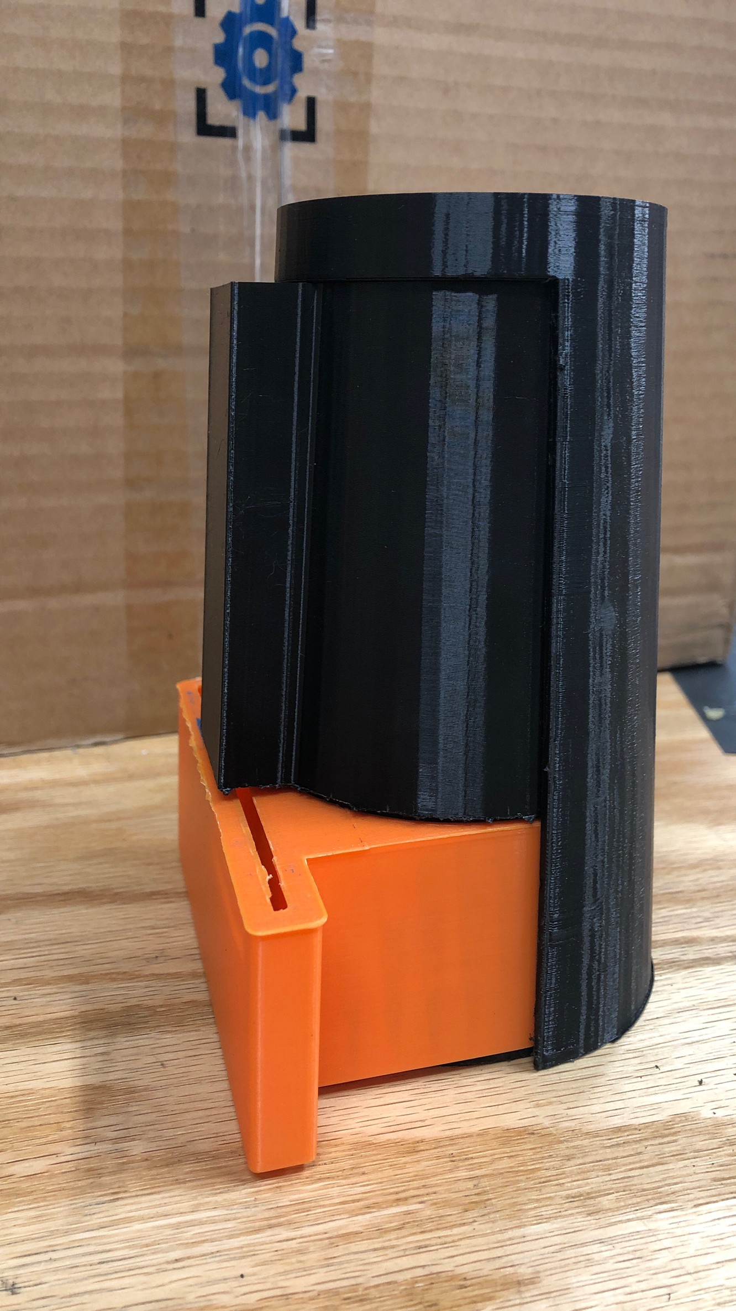
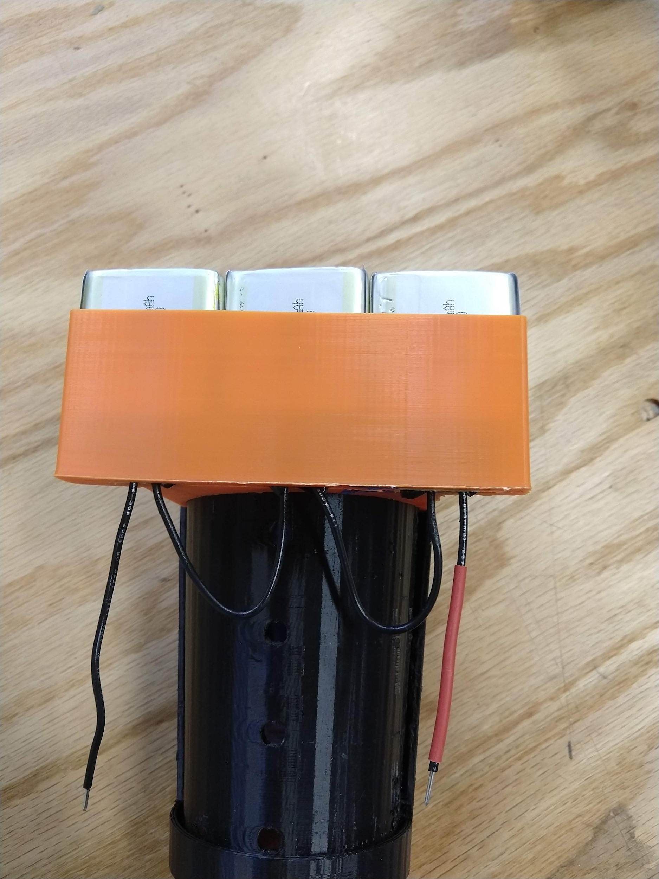
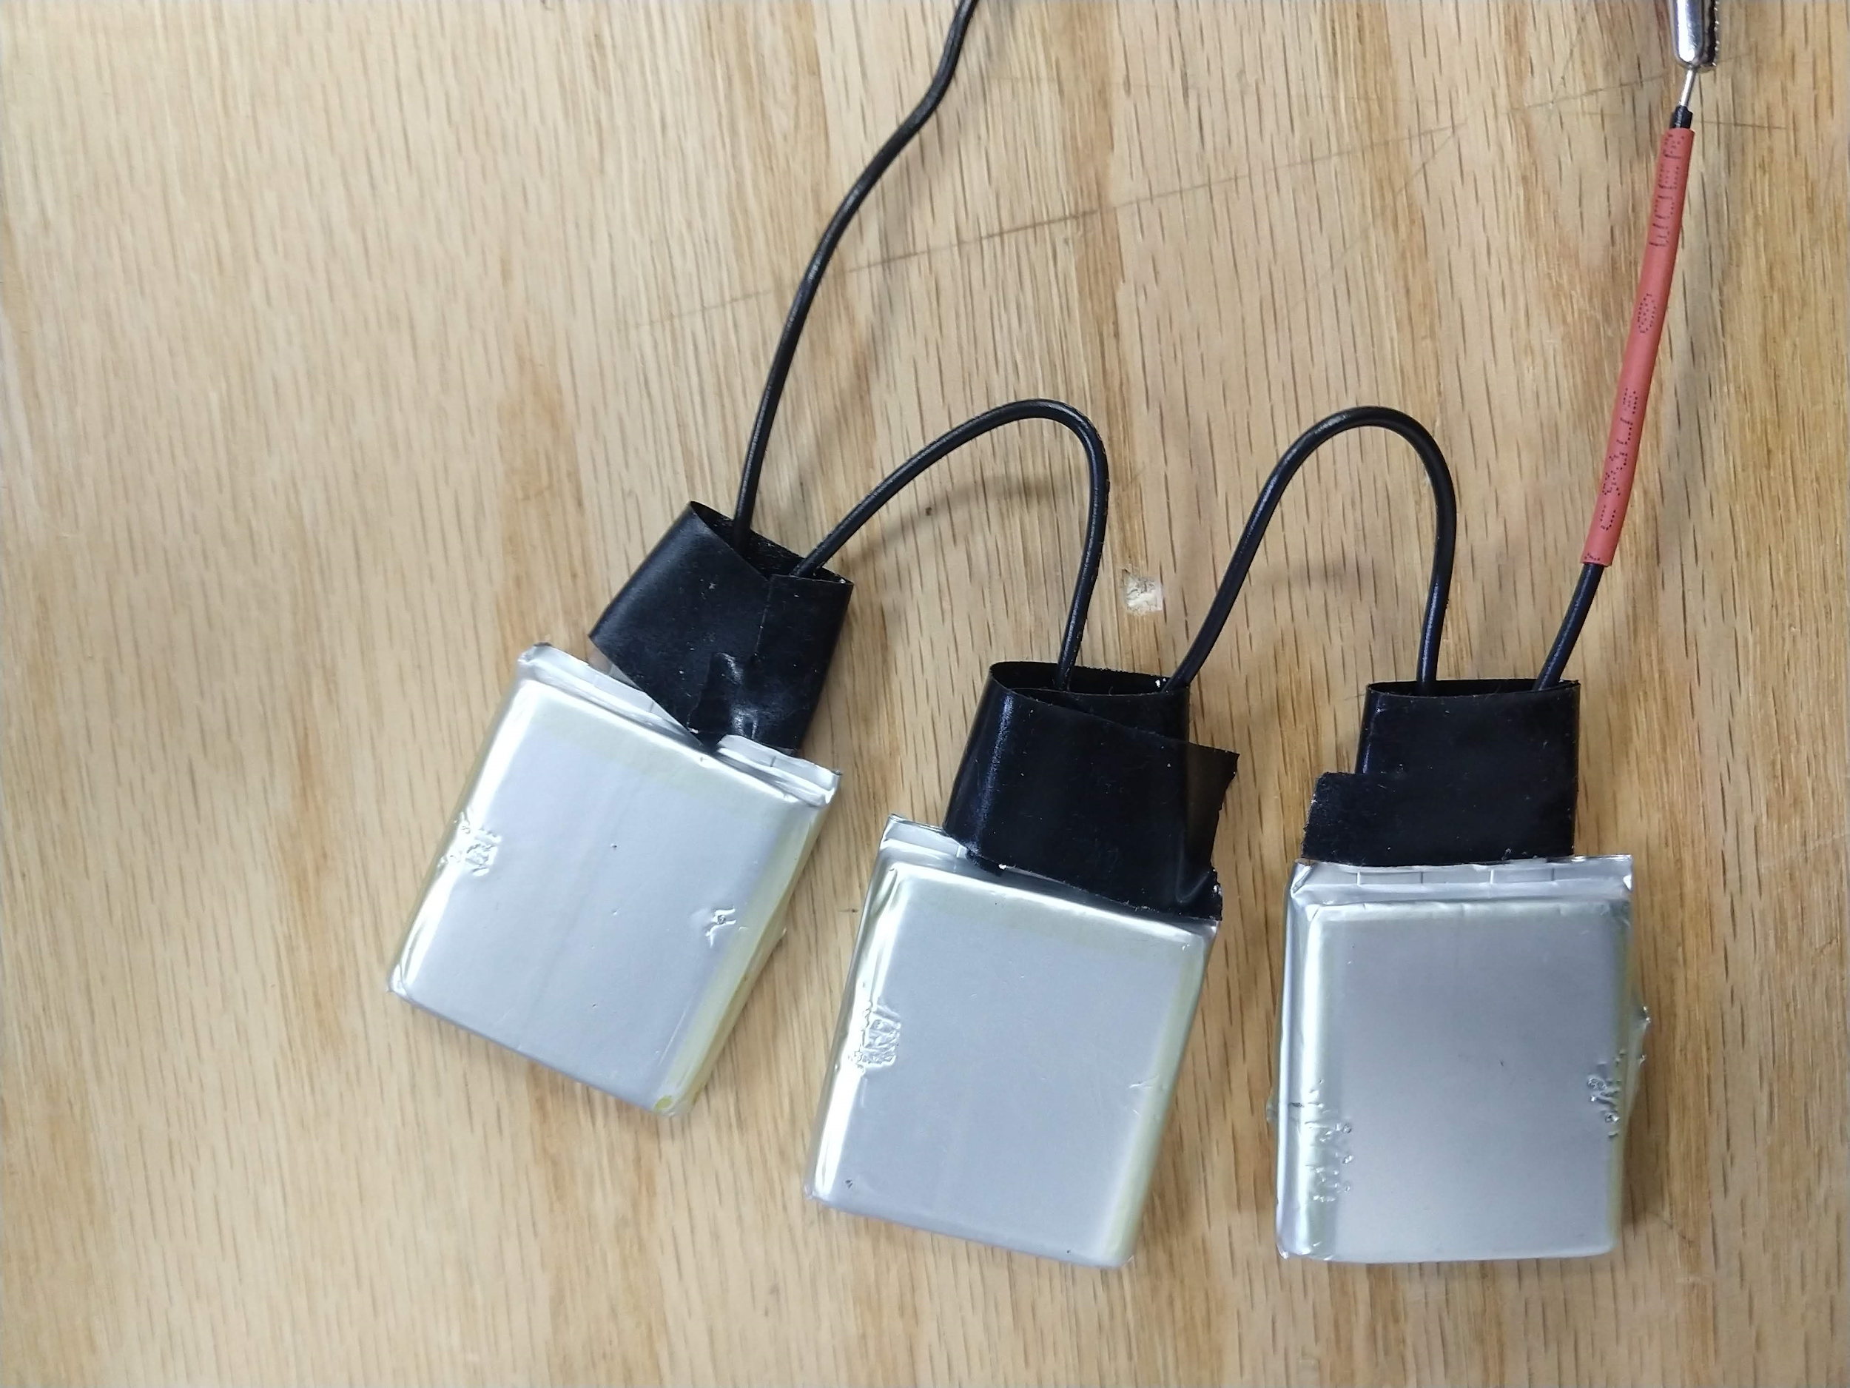
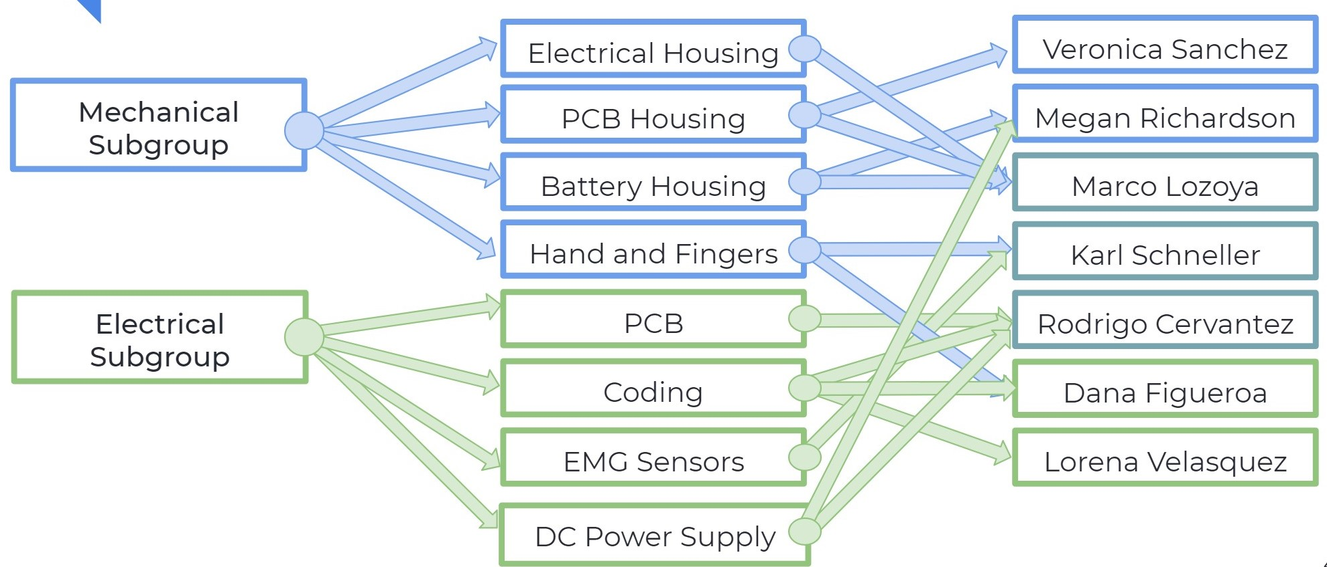
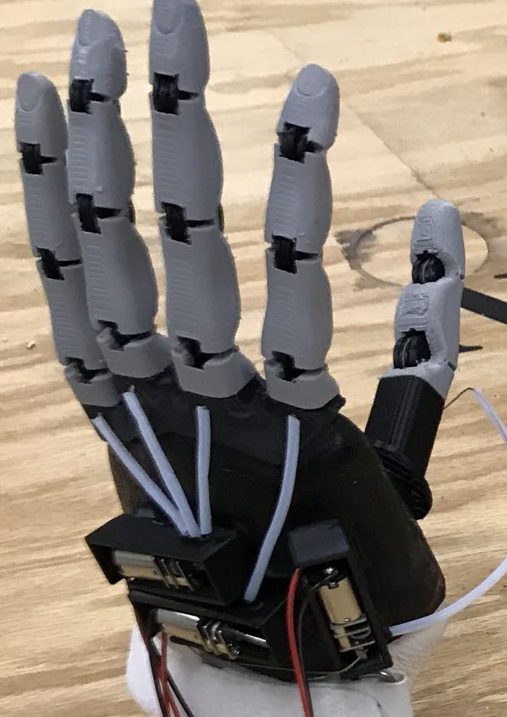
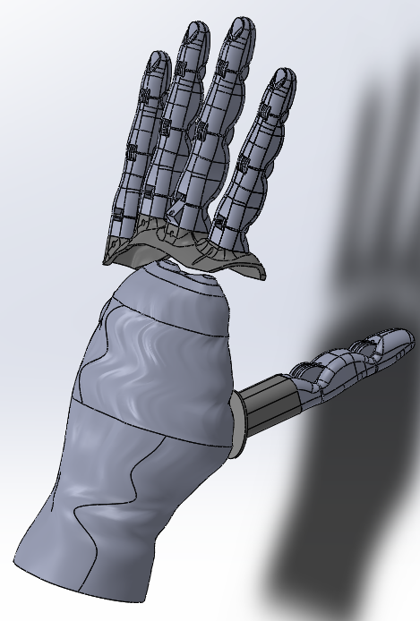
Steinhoff Prosthetic Research Initiative
Academic Advisor: Dr. Mostafa Hassanalian
Marco Lozoya (Lead), Karl Schneller (Co-Lead), Lorena Velasquez (SO), Rodrigo Cervantes (PO), Veronica Sanchez, Megan Richardson, Dana Figueroa
Background and Objective
EMG sensor placement worked best for the prosthetic when placed on the arm than
Created electronic compartment and battery housing.
Designed a lightweight battery pack
Redesigned electronic compartment and battery housing to be compact and easier to use
Redesigned the Servo horns to optimize the finger actuation with a new motor housing.
Redesigned fingers on the prosthesis to allow for greater mobility as well as easier user interface.
Created PCBs that include A4950 motor drivers, Adafruit ItsyBitsy, and other electrical components to reduce the wiring of the prosthetic device.
Results
Conclusion
The purpose of this project is to create a custom prosthetic for Edie Steinhoff, a New Mexico Tech Employee.. The team has continued to research innovative ways to provide Edie with a final prosthetic that has accurate grip type classifications and high-level control while also being developed at a low cost since 2017..
While redesigning the prosthesis so that the PCB, battery pack, and motors could all fit into the electrical-component housing, we realized there is a limit to how sleek the prosthetic can get. While doing this we realized that the compact assembly of the prosthetic was more bulky than expected meaning in the future, there may be need for further revisions on how to add more support for the electronics housing. The recreation of the the tab on the fingers to stop the string from slipping out of the track to allow the fingers to move. It did not print out as successfully as it should have so that will need to be improved.
Design Requirements
Figure 2 : Electronic housing and battery housing fully assembled(right). Palm with the Electronic assembly (center). PCB that fits into the PCB housing (left).
Future Work Spring 2021
The goal of the finished design is to meet the following requirements:
Simple, sleek, and low maintenance design
Moderate cost in the range of ~$500 to $600
High dexterity and mobility
Highly Responsive
In Spring of 2020 the team plans to complete the following tasks:
Assemble the palm of the hand with the fingers
Connect hand to electronic housing through fabric
Ensure that the fingers can properly move with the correct movement.
Make sure the Emg sensors work with the code.
Ensure the prosthetic is comfortable for use
Previous Work
Fall 2020 Design Team
Used EMG sensors
Smaller motors
Compact design
Redesign of fingers
Different printing material
New socket
Wiring Diagram
Figure 1: Fall 2019 assembled prosthetic
Figures 3 and 4: The new battery pack fully soldered (left) and the battery pack housing attached to the electronic housing (right)

