Slide 1
Occupational Heat Exposure
Control and Prevention Practices
New Mexico Institute of Mining and technology

Slide 2
DISCLAIMER
The training and educational materials were produced under grant SH-05048-SH8 from the Occupational Safety and Health Administration, U.S. Department of Labor. It does not necessarily reflect the views or policies of the U.S. Department of Labor, nor does mention of trade names, commercial products, or organizations imply endorsement by the U.S. Government.

Slide 3
Pre-test
The purpose of the pre-test is to evaluate your knowledge about heat stress and heat exposure consequences
It will help you know what will be covered during the training
The pre-test will be compared to a post-test and helps us determine how we did during the training

Slide 4
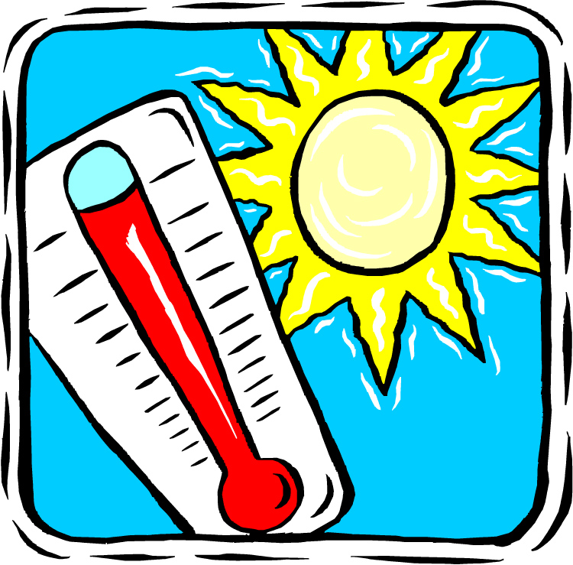
OBJECTIVES
Heat Stress
Heat Exposure and Health Hazards
Heat Exposure and Safety Hazards
Heat Stress Measurement
Heat Stress Exposure Control and Prevention
www.osha.com

Slide 5
Part 1
UNDERSTANDING HEAT
What is heat?
What is heat stress?
Why is it important?

Slide 6
HEAT STRESS
The net heat load to which a worker is exposed
Heat Sources
External heat load | Internal heat load
Temperature | Metabolic heat
Humidity | Physical activity
Clothing
Environmental heat
Metabolic heat
Physical activities
Clothing insulation

Slide 7
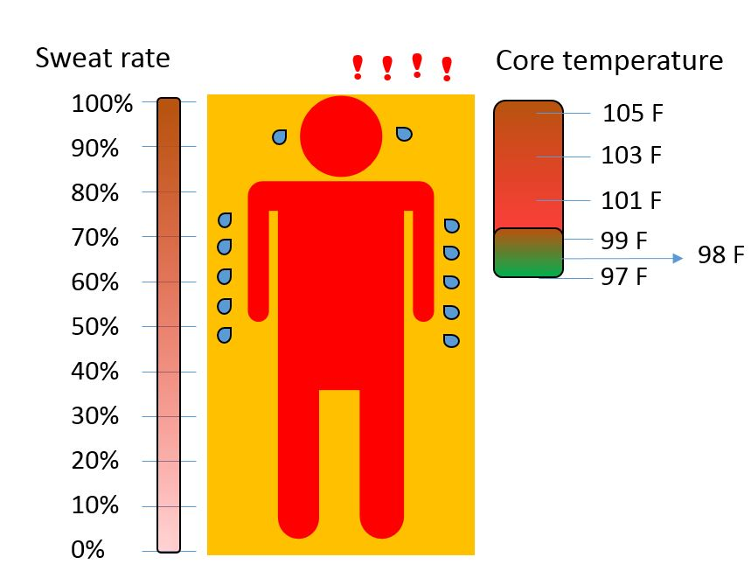
HOW HUMAN BODY WORKS?
Our body has mechanism to reject heat and control body temperature
How are body reacts
Core temperature must remain constant
Sweat rate | Increase
Heart rate | Increase
Blood pressure | Decrease
Skin temperature | Increase
Core temperature | Increase

Slide 8
PERSONAL AND ENVIRONMENTAL FACTORS
Personal Factors
Environmental Factors
Personal factors | Personal behaviors
Age Gender Fitness Obesity Past history of heat illness History of other diseases Experience and skills Knowledge Mental capacity | Life style Drug and alcohol use Medication use Smoking Sleep quality
Environmental factors | Behavioral factors
Air temperature Humidity Wind speed Radiant temperature | Level of activity Clothing

Slide 9
Part 11
HEAT IS A HEALTH HAZARD
ARE YOU PROTECTED?

Slide 10
HEAT STRESS HEALTH HAZARDS
Health Hazards
Discomfort
Heat rash
Heat syncope
Heat cramp
Heat exhaustion
Heat stroke

Slide 11
HEAT STRESS HEALTH HAZARDS (handout 1)
What you need to know:
Causes
Signs and symptoms
Risks
First aid and treatment
Prevention

Slide 12
HEAT Exhaustion vs HEAt Stroke
Heat Exhaustion
Heat Stroke
Signs
Faint or dizzy
What to do
Notify your supervisor
Excessive sweating
Cool, pale, or clammy skin
Nausea or vomiting
Rapid, weak pulse
Muscle cramps
Get to a cooler area
Drink water (if you are fully conscious)
Use cold cloths or compresses
Signs
Headache
What to do
CALL 9-1-1
No sweating
Nausea or vomiting
Rapid, strong pulse
May lose consciousness
DO NOT GIVE FLUIDS
Notify your supervisor
Move the person to a cooler area

Slide 13
Class Discussion – Heat illnesses
How can we prevent heat stress illnesses?
1
11
111
111
111

Slide 14
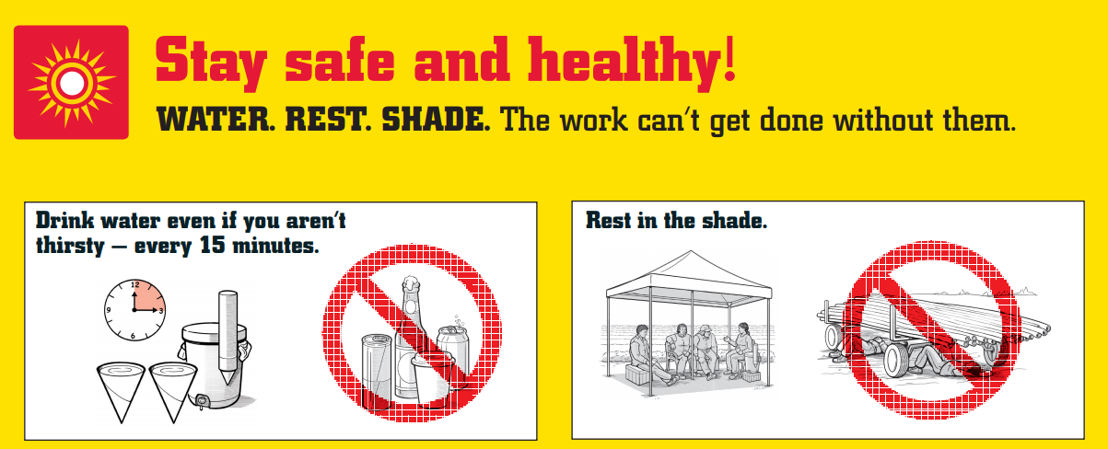
Water – REST - SHADE
Allow your body to rest and cool down
www.osha.com

Slide 15
Hydration program
It is important to consume pure and cool potable water throughout the shift
Employees
Frequently drink water and not wait until thirsty – at least 1 cup every 15-20 minutes
Locate water containers as close as possible
Do not use water from irrigation, sprinklers or fire systems
Do not share cups and dispose properly
Employers
Water quantities need to be sufficient and at least 1 quart per worker per hour for the entire shift
Ensure water containers are clean and sanitary
Ensure water containers are filled at a sanitary location
Provide disposable cups
Develop and encourage a hydration program

Slide 16
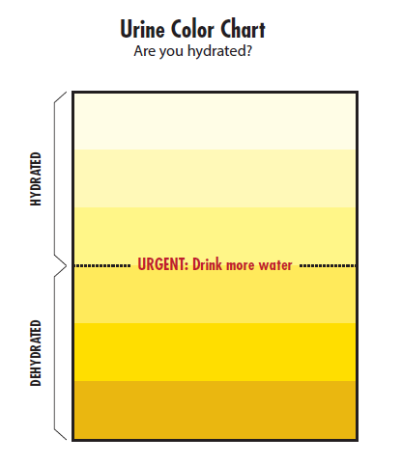
Monitoring of urine color
Urine color chart
Normal urine should be pale yellow
Darker urine can indicate dehydration
Some diets, medications and illnesses may affect results
Adapted from NIOSH

Slide 17
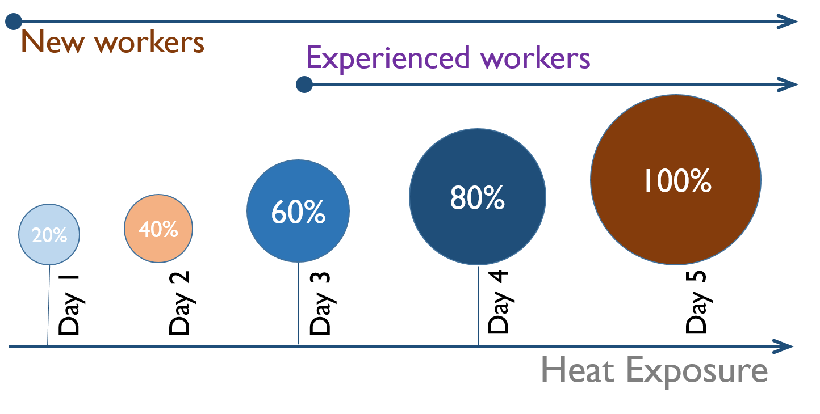
Acclimation
Physiological and Psychologic adjustment to heat exposure
Develop the capability of workers to perform their activities at a job in the hot environment
Decrease the risk of heat-related illnesses and hazardous behaviors
Increase the efficiency of sweating
Adjust replacing the water loss due to sweating
Adapted from NIOSH

Slide 18
Part 11i
HEAT IS A SAFETY HAZARD
ARE YOU PROTECTED?

Slide 19
HEAT STRESS SAFETY HAZARDS
Safety Hazards
Carelessness
Fatigue
Loss of concentration
Impaired mental capacity
Inability to make decision
Misapplication of PPE

Slide 20
Fatigue
A state of extreme tiredness resulting from mental or physical exertion
INCREASE
- Risk taking
- Errors in judgement
- Forgetfulness
- Accident rate
DECREASE
- Decision making ability
- Performance
- Reaction time
Attention

Slide 21
Fatigue – Important Factors
FATIGUE HAS NOTHING TO DO WITH YOUR JOB SKILLS LEVEL
Personal
Sleep quality
Diet
Environmental
High temperature
Limited visibility
Alcohol
Knowledge
State of health
High noise
Long shifts
Repetitive tasks

Slide 22
Fatigue – PREVENTION AND CONTROL
Employees
Employers
Eat well – Eat a healthy diet that gives you sufficient energy throughout your shift
Stay positive during your job
Stay alert and look after your co-workers
Ask your employers for training and educational materials
Try to enjoy your job and take a break if necessary
Communicate!!!
Train your workers and ensure they have enough knowledge about fatigue
Vary job tasks to avoid repetition
Encourage breaks during long shifts
Introduce shorter shifts specially to those who are under direct sun light
Ensure that the environment is safe
Encourage your workers to communicate with you!!

Slide 23
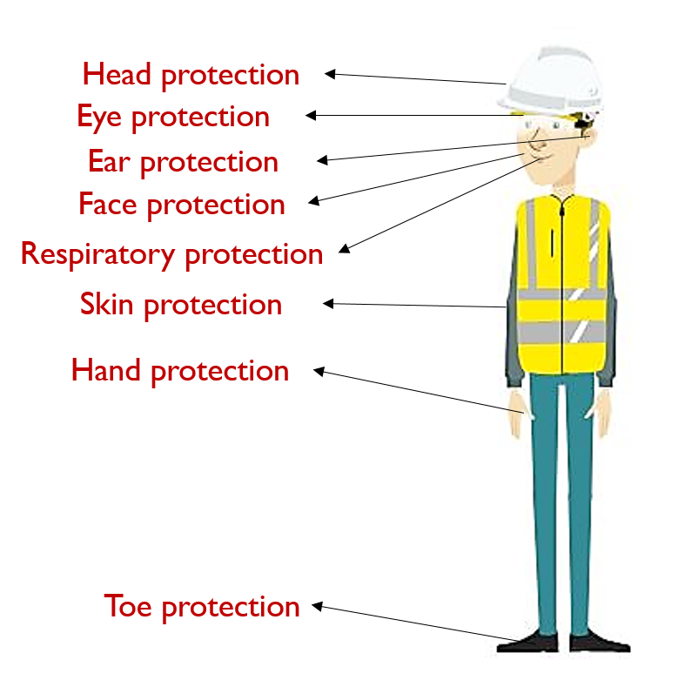
PERSONAL PROTECTIVE EQUIPMENT (PPE)
ARE YOU PROTECTED?
PPE requirements are different from site to site
The main aim of using PPE is to protect yourself against health and safety hazards
You must be trained in order to use the PPE properly
PPE is the least effective method of controlling and preventing the hazards
However, it reduces occupational injuries and illnesses

Slide 24
MISAPPLICATION OF PERSONAL PROTECTIVE EQUIPMENT (PPE)
DO’s
DON’Ts
PPE must be worn at all time at jobs
Follow the instruction for proper use of PPE
Take several breaks during the shift hours
In in areas that use of PPE is not required
Communicate with your supervisor about possible hazards
Look after your coworkers and report misapplication of PPE
Drink plenty of water
Do not remove your PPE when it is required
Do not alter your PPE
Do not rest in the areas where PPE is required
Do not remove somebody else’s PPE unless you are told by your supervisor
Do not wear dark cloths
Do not take shortcuts

Slide 25
Class Discussion
PPE - Application and misapplication
1
11
111
111
111

Slide 26
Part iv
Heat Stress Measurement
HEAT STRESS INDEX

Slide 27
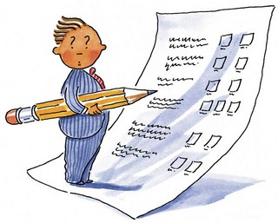
thermal Comfort Evaluation
Subjective Evaluation (Asking)
The traditional 7-point “status” scale:
cold | cool | slightly cool | neutral | slightly warm | warm | hot
An alternative “action” scale:
Would you prefer: to be warmer | no change | to be cooler
- A post-occupancy evaluation (POE) tool
If workers are in the environment being evaluated

Slide 28
Measurement of Heat stress
Heat Stress Index
Heat stress index is an indicator
Each heat stress index is developed for a specific application (there are over 160 heat indices)
It takes into account some of the environmental and behavioral parameters
Provides risk level and possibly work-rest cycles according to the level of danger
It can be used as baseline for heat exposure safety measures

Slide 29
Necessary Steps
M
Temperature, humidity, wind speed, …
C
Use table of equation to calculate the index number
A
Apply the recommended actions
Correct for level of activity, clothing, and exposure conditions
Provide feedback to the supervisor
MEAUSURE – CALCULATE – ACT

Slide 30
Heat Index (Handout ii)
Heat Index (OSHA recommended index)
DO’s and DON’Ts
Heat Index is an indicator
Outdoor workers are exposed to higher level of heat exposure if work in direct sun light
Take into account the effects of PPE, level of activity, and impermeable cloths
The reaction to heat exposure is different from individual to individual
Understand the Heat Index and learn how to calculate it
Always follow the instructions according to the safety plans
Implement safety measures if work in direct sun light
Communicate with your supervisor and your coworkers about possible hazards
DO NOT only rely on Heat Index. People react differently to the heat exposure
DO NOT skip rest cycles when necessary
DO NOT work by yourself if risk level is high

Slide 31
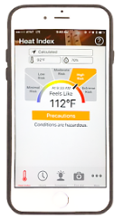
Heat Index – Mobile App
A visual indicator of the current heat index and associated risk levels specific to your current geographical location
Precautionary recommendations specific to heat index-associated risk levels
An interactive, hourly forecast of heat index values, risk level, and recommendations for planning outdoor work activities in advance
Editable location, temperature, and humidity controls for calculation of variable conditions
Signs and symptoms and first aid information for heat-related illnesses
Adapted from NIOSH

Slide 32
parameters that cannot be measured
Personal Factors
The personal factors cannot be included in a thermal model
It is critical to understand that body response to heat exposure is different from person to person
Personal factors | Personal behaviors
Age Gender Fitness Obesity Past history of heat illness History of other diseases Experience and skills Knowledge Mental capacity | Life style Drug and alcohol use Medication use Smoking Sleep quality

Slide 33
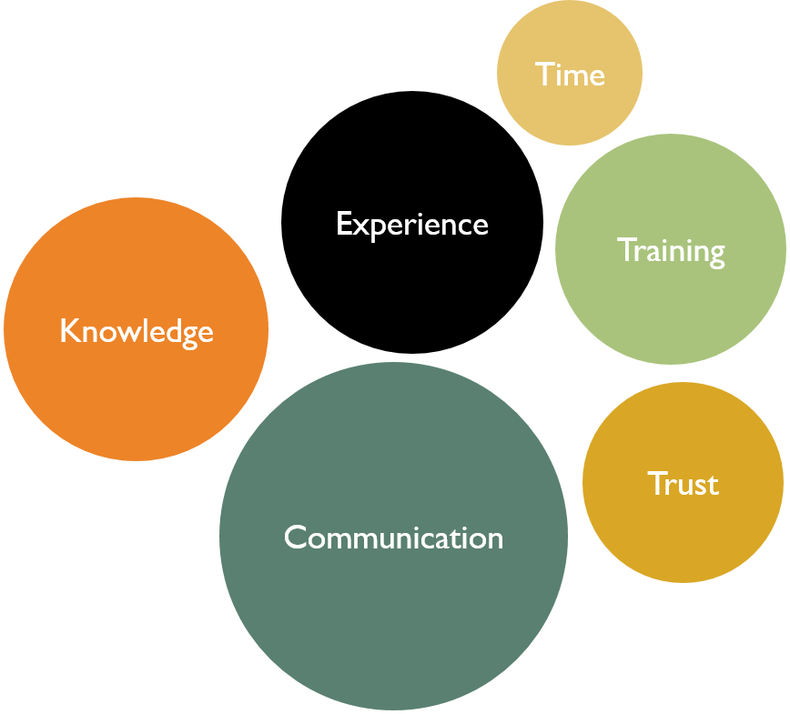
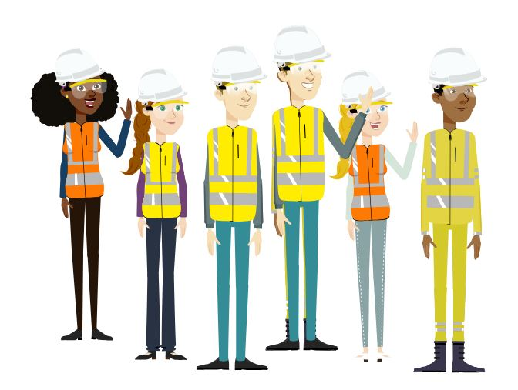
Self-Paced work
The self-paced workers are well-informed, educated individuals who can regulate their work-rate and is not subject to supervisor pressure

Slide 34
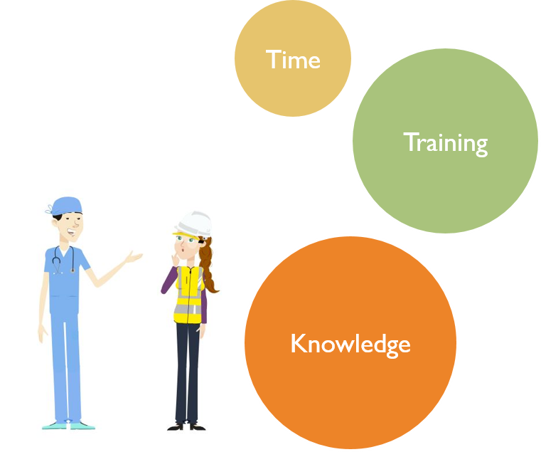
importance of training
Training
Regular training
Training during specific time
Educational materials
Self-learning, self-awareness
Sings, posters, pamphlets, …

Slide 35
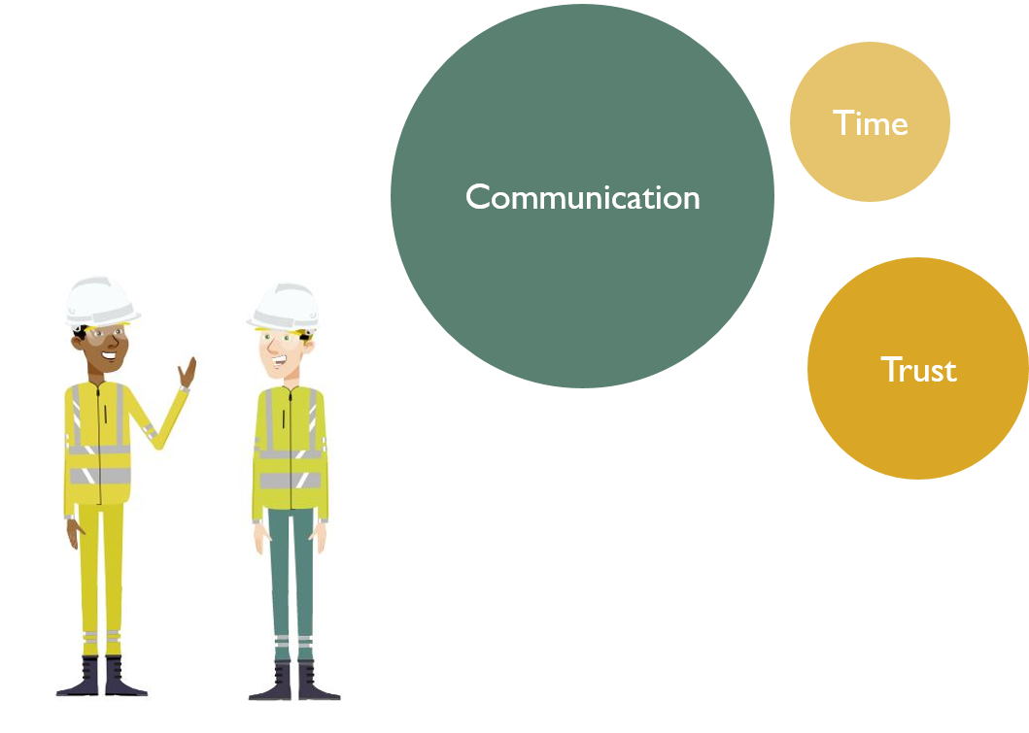
importance of communication
Employer
Trust your worker
Conduct subjective evaluation
Educate your worker
Take alternative actions
Modify tasks and schedules
Employees
Communicate with you employers
Speak up
Trust you employer

Slide 36
Buddy system
Develop a buddy program at workplaces
Watch any sign or symptoms
Communicate with your crew if you see any signs
Encourage your crew to rest if necessary
Provide information to your supervisor
Provide first aid if you received proper training

Slide 37
Thank you!
Take Post-Test and Complete Survey
The post-test and survey helps us determine if we did a good job or need to make improvements in certain areas

